Slide 1
Colorectal cancer diagnosis from histology images:
A comparative study
Honghao Zheng

Slide 2
Introduction
developed by advanced of ML
Detection & Identification Colorectal cancer
Improvement from Tradition ML to Deep CNN
Transfer Deep CNN model

Slide 3
The paper Aim
Which machine learning based approach is best suited for this problem?
Are the features learnt from large-scale natural image datasets transferrable to cancer diagnosis?
Does training a compact CNN from scratch provide a better alternative to fine-tuning deep pre-trained models?

Slide 4
Dataset
Tubular Adenoma with low-grade dysplasia
Hyperplastic poly (HP)
Normal
Cancinoma
50*4 image

Slide 5
Data Arugument

Slide 6
Image Enlarge
1*640*480 Image
4*300*300 patch
Each patch extract 20 features
Dataset 50 original images * 20 feature = 1000patch and 4*1000 Images as input data

Slide 7
Traditional Learning
Feature Extraction descriptor
  Local Binary Pattern(LBP) , rotational invariant LBP(rLBP)
  Local Phase Quantization(LPQ), rotational invariant LPQ(rLPQ)
  LBP and LPQ can be combined( LBP+LPQ)
Classification Algorithm: SVM

Slide 8
Transfer CNN
Extract knowledge from a source problem and applying it to an unrelated target
Move bottom to the top of architecture making features specific for the tasks
retaining the architecture of the original pre-trained CNN model and either using its first few layers as feature extractors, or incrementally updating the weights by resuming training using the data belonging to the task.

Slide 9
IncV3

Slide 10
Transfer CNN on IncV3

Slide 11
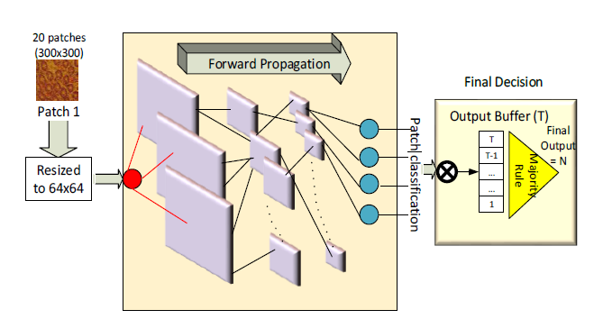
Adapative CNN
Parameter Name | Value
Convolutional filter Size | 5
Subsamplling factor | 2
CNN Layer | 3
MLP Layer | 2

Slide 12
Performance Evalution
5 fold cross validation
Train-test split percentage set to 80%
160 images and corresponding 3200 patches used in train and rest in test set

Slide 13
Result of the Traditional ML
Method | Cancer Identification |  |  | Cancer Dectection
 | RBF | Linear | Poly. | RBF | Linear | Poly.
rLPQ | 67.5 | 74 | 71 | 84.5 | 87 | 83.5
rLBP | 58 | 57.5 | 65.5 | 81 | 82.5 | 86
Uni rLBP | 56.5 | 54 | 59.5 | 80 | 79.5 | 83
Haralick | 38 | 40 | 42.5 | 71 | 65 | 73
rLPQ + rLBP | 64 | 73.5 | 74 | 84 | 86 | 87

Slide 14
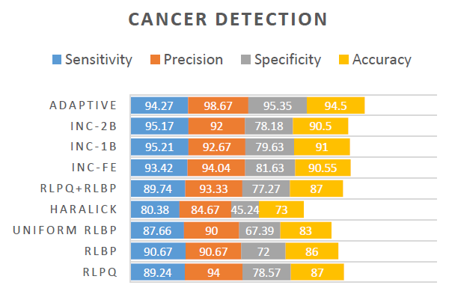
CNN Detection

Slide 15
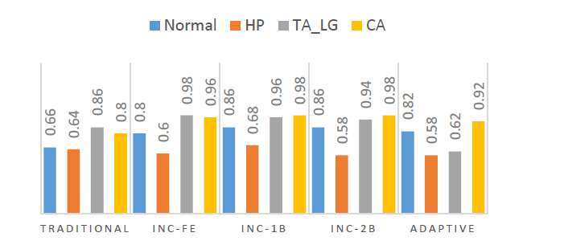
CNN Cancer identification

Slide 16
Answer of Q&A
Q: Which machine learning based approach is best suited for this problem?
A: Deep CNN
Q: Are the features learnt from large-scale natural image datasets transferrable to cancer diagnosis?
A: Inception V3 used, and we did the fine-tune on the interest task
Q: Does training a compact CNN from scratch provide a better alternative to fine-tuning deep pre-trained models?
A: we propose a systematic approach by a compact and adaptive CNN and compare its results with the fine-tuned models.

Slide 17
Thank you

